Slide 1
Progress Report (May 18, 2021)
Joey Q. Harap

Slide 2
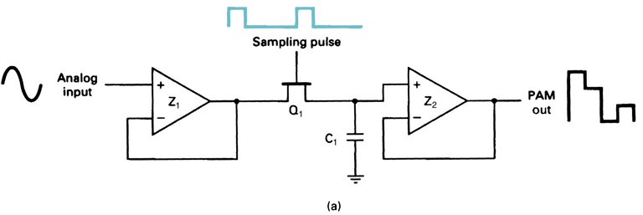
Sample And Hold Circuit
Schematic

Slide 3
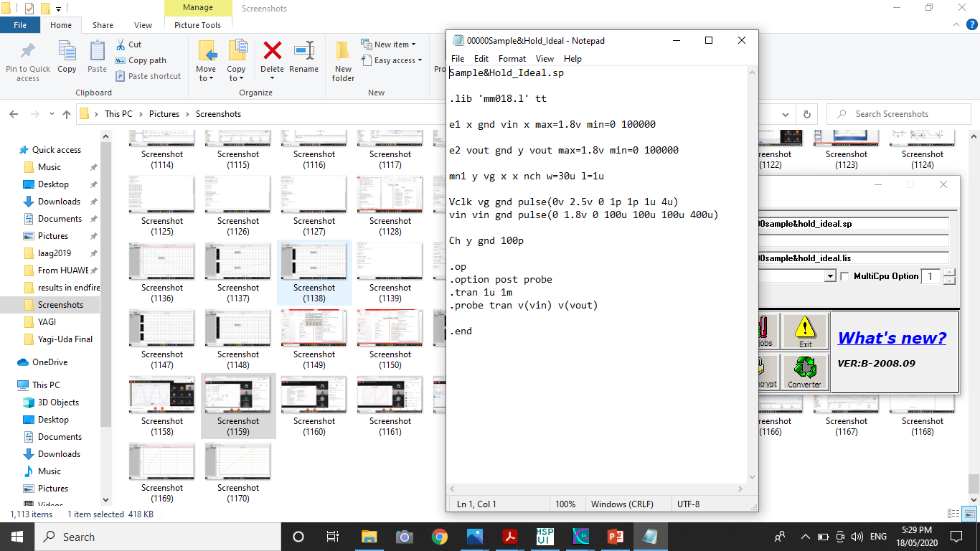
With Ideal Op Amp

Slide 4
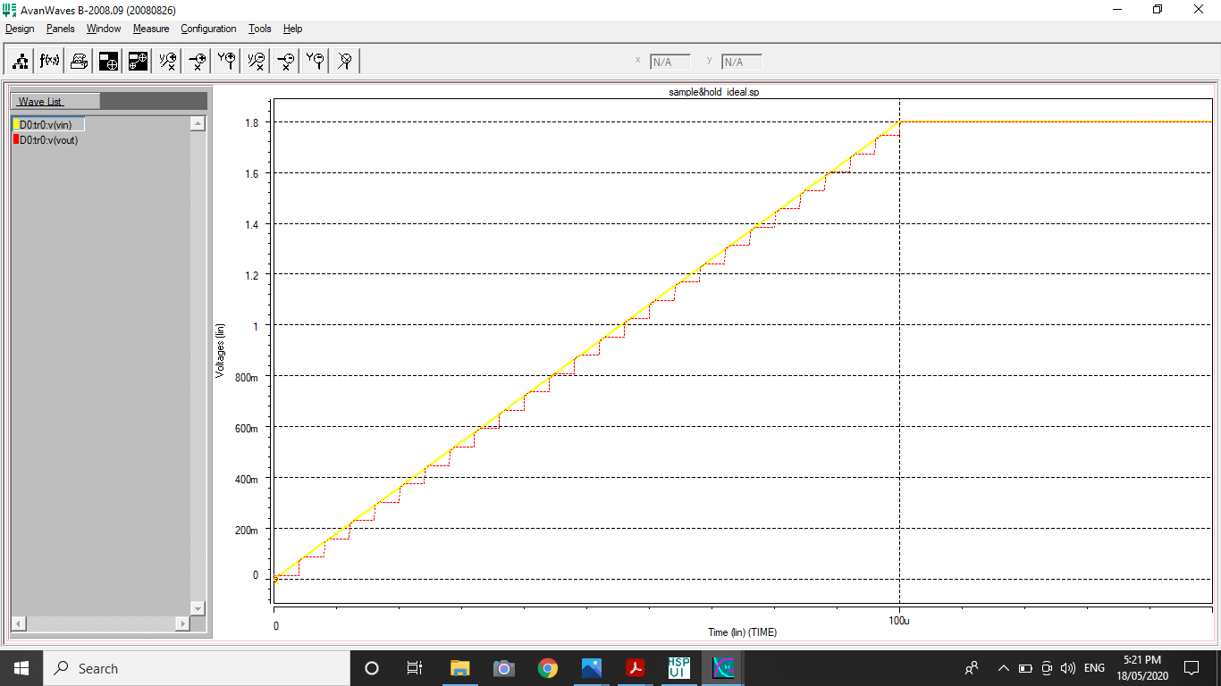
Result

Slide 5
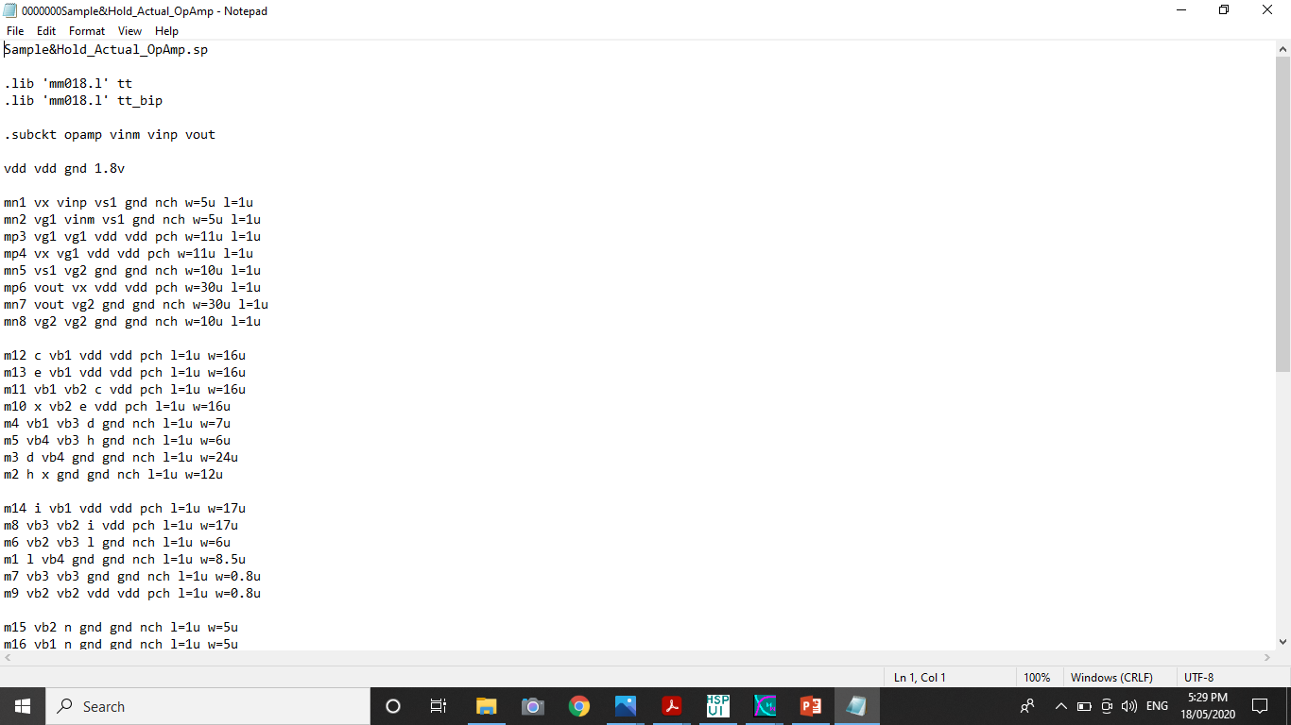
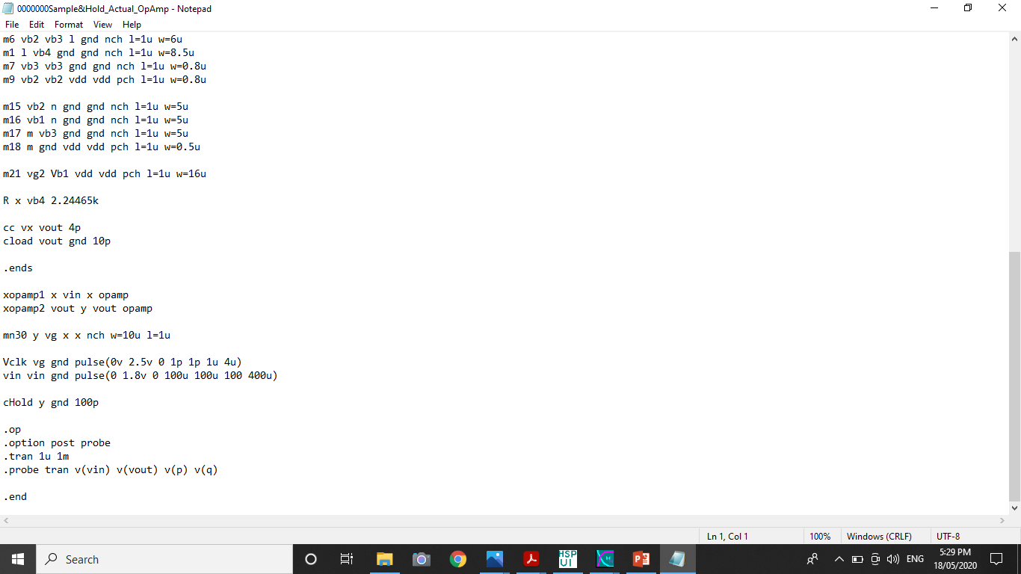
With an Actual Op Amp

Slide 6
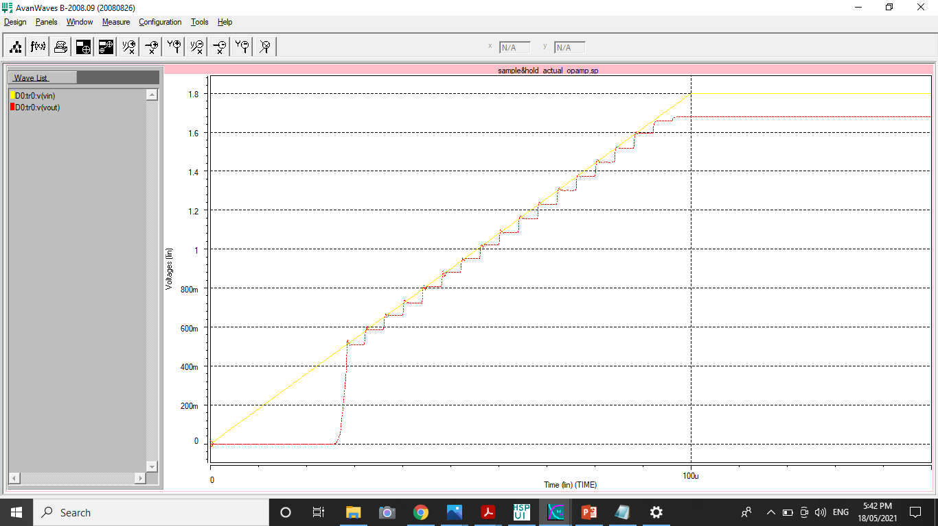
Result

Slide 7
Thanks

